Slide 1

Introduction to Accounting
Accounting is vital for businesses. It aids in making informed decisions. There are different types of accounting. These include financial, managerial, tax, and auditing.
DB
by Debanshu Bhoi

Slide 2

Core Accounting Principles (GAAP)
GAAP ensures financial reporting is consistent. Key principles are accrual basis and going concern. The matching principle and cost principle are also important. GAAP makes financial data comparable.
Accrual Basis
Going Concern
Matching Principle
Recognize revenue when earned, not when cash is received.
Assume the business will continue operating in the foreseeable future.
Match expenses with the revenues they help generate.

Slide 3




The Accounting Equation
The accounting equation is fundamental. Assets equal liabilities plus equity. Transactions impact this equation. This maintains balance after every transaction.
Assets
What the company owns.
Liabilities
What the company owes to others.
Equity
The owner's stake in the company.

Slide 4




Financial Statements: Income Statement
The income statement reports financial performance. It covers a specific period. Key components include revenues and expenses. It shows gains and losses as well.
Revenue
Expenses
Net Income

Slide 5
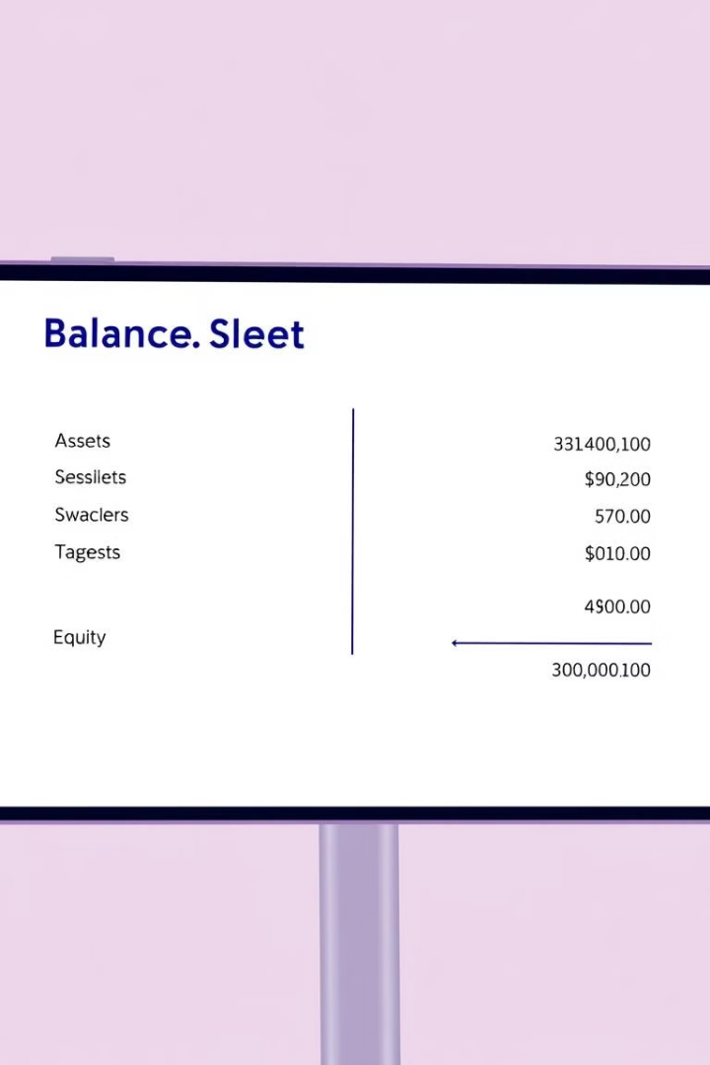
Financial Statements: Balance Sheet
The balance sheet reports a company's financial position. It is for a specific point in time. It shows assets, liabilities, and equity.
1
Assets
What the company owns.
2
Liabilities
What the company owes.
3
Equity
The owner's investment.

Slide 6
Financial Statements: Cash Flow Statement
The cash flow statement tracks cash movement. It shows cash both coming in and going out. It covers a specific period.
Operating Activities
Investing Activities
Financing Activities
Cash flow from normal business operations.
Cash flow from buying or selling assets.
Cash flow from debt and equity.

Slide 7



Key Accounting Concepts
Depreciation allocates asset costs. Inventory valuation assigns costs to inventory. Accruals and deferrals recognize revenues and expenses correctly.
Inventory Valuation
Depreciation
Accruals
2
1
3

Slide 8

Conclusion
Accounting is key for financial transparency. It is also vital for informed decision-making. Core principles and statements are essential. Continuous learning is highly encouraged.
Financial Transparency
Informed Decisions
Continuous Learning

